Slide 1
Week 14
Detecting and managing infections

Slide 2
How can I tell there is an issue?
Slow
Pop-ups
Unusual activity
Redirecting webpages
Excessive CPU usage (task manager)
Ads where there shouldn’t be
Connections to unknown machines

Slide 3
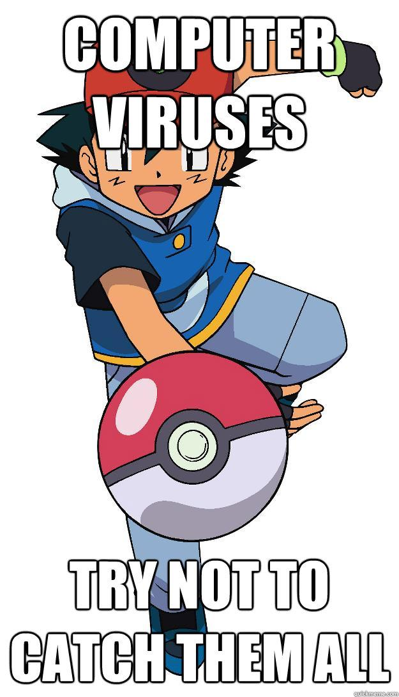
What is it?
Viruses
Trojans
Spyware
Adware
Rootkits

Slide 4
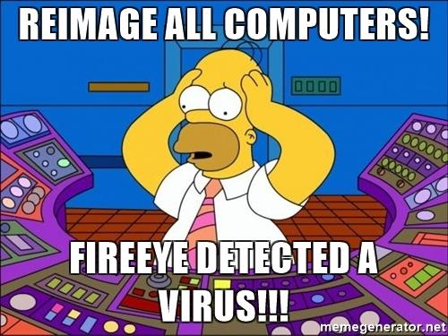
How corporate fixes this
Wipe and reimage

Slide 5
How do you fix at home step 1
Backup before you start!
Disconnect from internet
Start in safe mode

Slide 6
Fix at home step 2
Start with a 1 time analyzer (not normal AV)
  Malwarebytes https://www.malwarebytes.com
  Microsoft malicious software removal tool https://www.microsoft.com/en-us/download/details.aspx?id=9905
  ClamWin http://www.clamwin.com
Always use clean fresh download of the tool
Can use more than 1 tool

Slide 7
Fix at home step 3
Check for adware
  Adaware https://www.adaware.com
  Spybot https://www.safer-networking.org

Slide 8
Fix at home step 4
Check for rootkits
TDSSKiller https://usa.kaspersky.com/downloads/tdsskiller

Slide 9
How do I stop this in the future?
Regular AV scans
  Make sure its updated
  Make sure AV is active
  Only install 1 AV on your machine at a time, more isn’t better
Regular adware scans
Use a firewall
Practice safe computing
  Including backups off site (ransomware)
Portable USB for Cleaning computers

Slide 10
Fake AI Tools
Only download AI apps and models from official sources
A fake OpenAI model on Hugging Face spread password-stealing malware, with 244,000 downloads before it was removed
  Source: BleepingComputer

Slide 11

Danger, Will Robinson! Danger!
Warning! Warning! Danger!
  HijackThis https://sourceforge.net/projects/hjt/
  Delete on boot (MoveonBoot) https://emcosoftware.com/move-on-boot

